Slide 1



Video games Review
Mini project 3
By Anton

Slide 2



Quest
STEAM : video game digital distribution service

Slide 3

Quest

Slide 4
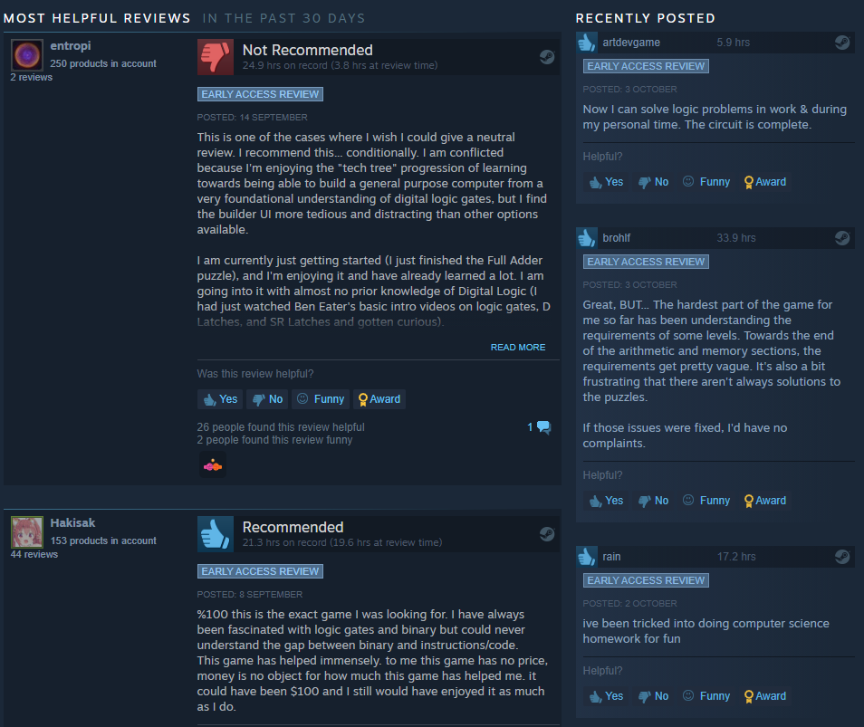
Quest

Slide 5
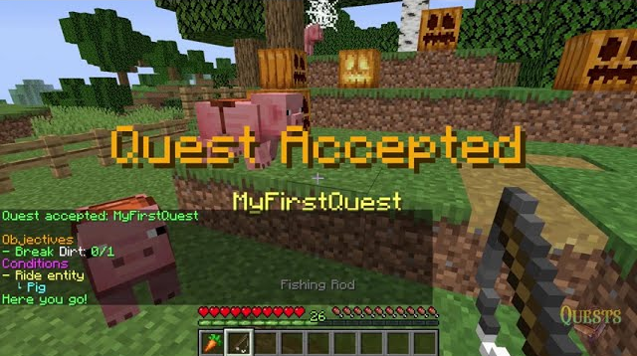
Quest
Predict whether the reviewer recommend a game using his review

Slide 6
Agenda
Quest
Exploratory Data Analysis
Data pre-processing
Modelling
Conclusion

Slide 7
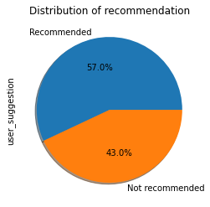
Exploratory Data Analysis
Data set from Kaggle
17,500 reviews from 44 different games
Binary classes
Baseline accuracy : 57%

Slide 8
Exploratory Data Analysis
WORDS SCALED
URL (http://)
Emojis/No ascii characters (♥,░█▄▀)
Spamming of punctuations (!!!!!!!!!!!!!!)
Words not English (三式戦)
English Mistakes (Januari,locatian)
F words (F*cking)
CHARACTERS SCALED
Korean/Mandarin/Japannese/cyrillic characters
Emojis (⭐)
Symbols (✎, ☠,…)

Slide 9
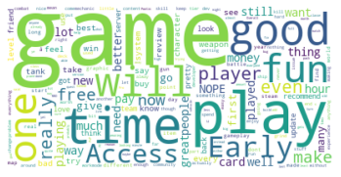


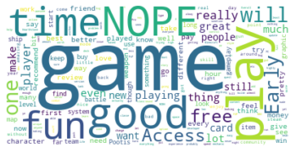
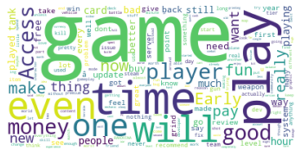
Exploratory Data Analysis

Slide 10
Data pre-processing
6 steps :
Basic cleaning
Remove Stops words
Lemmatisation
Stemming
Remove punctuation
Remove top common words
10/10 Deep and engaging story with well-rounded character progression. Found out using left hand to click is pretty easy. Will be recommending to my mother and sister ( ÃÂ¡Ã‚Â° ÃÅ“ÃŠâ€“ ÃÂ¡Ã‚Â°)

Slide 11
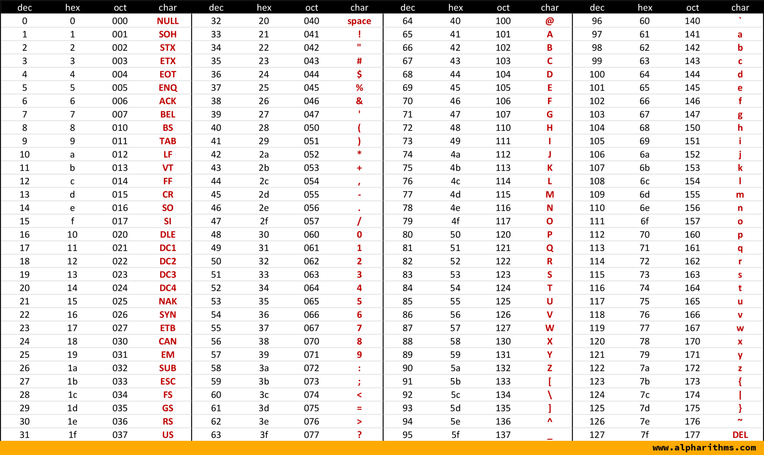
Data pre-processing
Basic cleaning
Remove Stops words
Lemmatisation
Stemming
Remove punctuation
Remove top common words
URLs
Extra dot
Extra whitespace
Word spamming
Word with more than 40 letters
Characters not included in the ASCII table
10/10 Deep and engaging story with well-rounded character progression. Found out using left hand to click is pretty easy.
Will be recommending to my mother and sister ( ÃÂ¡Ã‚Â° ÃÅ“ÃŠâ€“ ÃÂ¡Ã‚Â°)
10/10 Deep and engaging story with well-rounded character progression. Found out using left hand to click is pretty easy. Will be recommending to my mother and sister

Slide 12
Data pre-processing
Basic cleaning
Remove Stops words
Lemmatisation
Stemming
Remove punctuation
Remove top common words
10/10 Deep engaging story - rounded character progression . Found left hand click pretty easy . recommending mother sister
10/10 Deep engage story - round character progression . find left hand click pretty easy . recommend mother sister
10/10 deep engag stori - round charact progress . find left hand click pretti easi . recommend mother sister
1010 deep engag stori round charact progress find left hand click pretti easi recommend mother sister

Slide 13
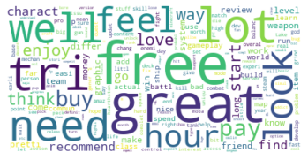
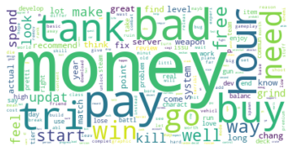
Data pre-processing
Basic cleaning
Remove Stops words
Lemmatisation
Stemming
Remove punctuation
Remove top common words
Top 20 most frequent words of each class
Find common words
Remove these words from the reviews

Slide 14
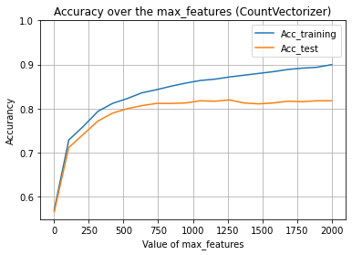
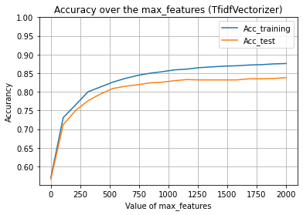
Modelling
Pre-processing? | Vectorizer|Estimator | Acc_training | Acc_ test | CPU Times
NO | CountVectorizer()|LogisticRegression() | 99.2% | 84.4% | 27.6 sec
YES | CountVectorizer()|LogisticRegression() | 97.3% | 82.6% | 7.08 sec
 | TfidfVectorizer()|LogisticRegression() | 90.0% | 83.9% | 3.52 sec
 | CountVectorizer()|SVC() | 92.6% | 83.2% | 123 sec
 | TfidfVectorizer()|SVC() | 98.5% | 84.5% | 158 sec

Slide 15
Conclusion
We can predict whether the reviewer recommend a game with an accuracy of ~84%
Further improvements :
Optimize estimator
Try to understand the reason of misclassifications (sarcasm,…)
Analyse with Part of Speech

Slide 16

thank attent question
“Thank you for your attention ! Have you any questions ?” after pre-processing

